Slide 1

CHRONIC DISEASES DATA ANALYSIS
GROUP-3
•Kushwanth Sai Chandu Meesala
•Sindy Siddharth Reddy Kolli
•Tharuni Tekula
•Yeshwanth LalpetVari

Slide 2
Objectives
Analyze chronic disease trends over time and across states to identify key patterns.
Examine disparity rates across states and demographics to uncover inequities.
Map geospatial patterns to uncover region-specific public health insights
Highlight key public health challenges and opportunities
Empower stakeholders with interactive tools to explore and interpret the data.
Provide insights for policymakers to improve health outcomes.

Slide 3
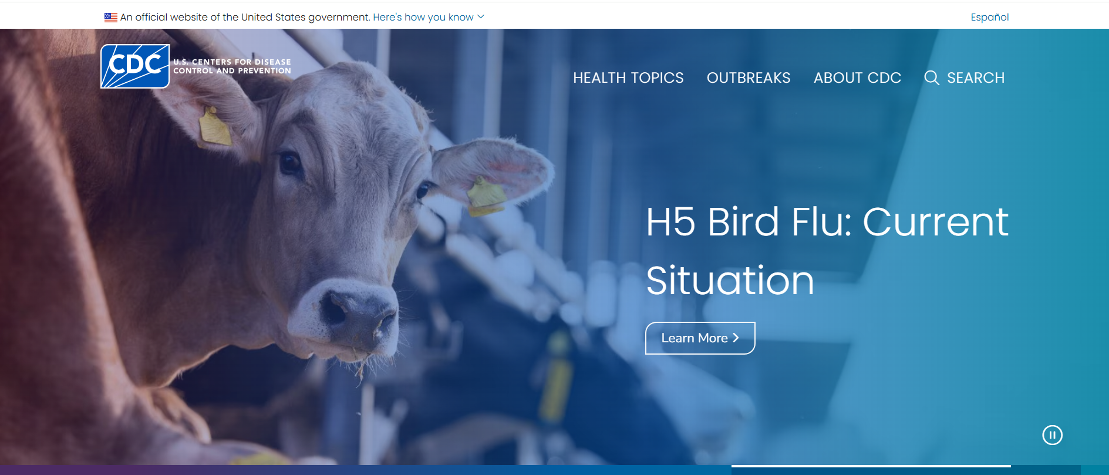
Data Source
The Chronic Disease Indicators (CDI) dataset is sourced from the CDC’s Centers for Disease Control and Prevention portal.
https://data.cdc.gov/Chronic-Disease-Indicators/U-S-Chronic-Disease-Indicators/hksd-2xuw/about_data

Slide 4
Data Description
The CDI dataset contains 309K rows across 34 columns, focusing on chronic diseases like diabetes, asthma, cancer, and sleep disorders.
Key data points include: Year, State, Topic, Question, DataValue.
Data covers various U.S. states, with data stratified by various categories like age, sex, and Race/Ethnicity.

Slide 5
Libraries
Pandas - For data manipulation and analysis.
NumPy - For numerical operations and handling missing values efficiently.
Matplotlib - Used for creating static, interactive, and animated visualizations such as graphs and charts.
IPython.display - For displaying HTML content (e.g., styled DataFrame tables)
Cartopy - For geospatial data visualization.
Dash - For building interactive, data-driven dashboards.

Slide 6

Code Demonstration

Slide 7
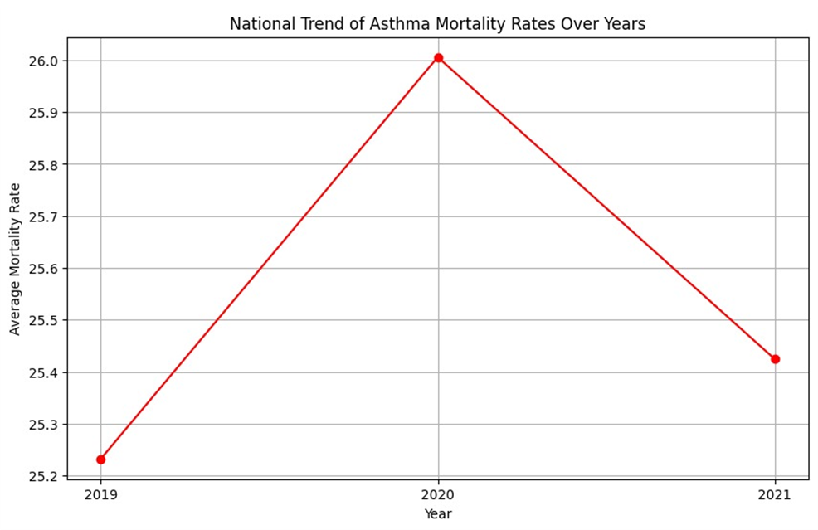
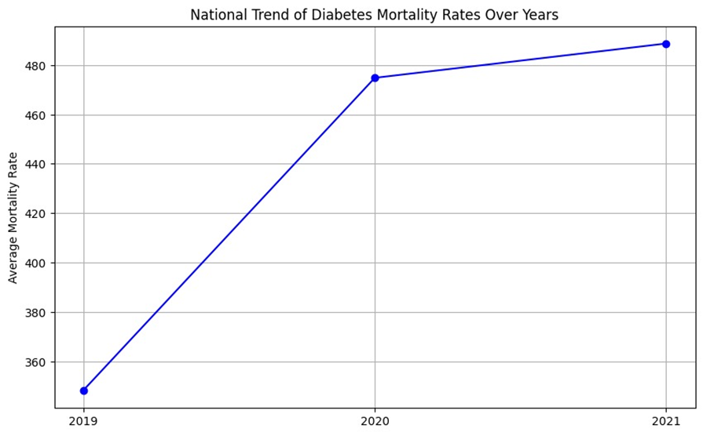
Analysis
National Trend of Asthma & Diabetes Mortality Rates Over Years

Slide 8
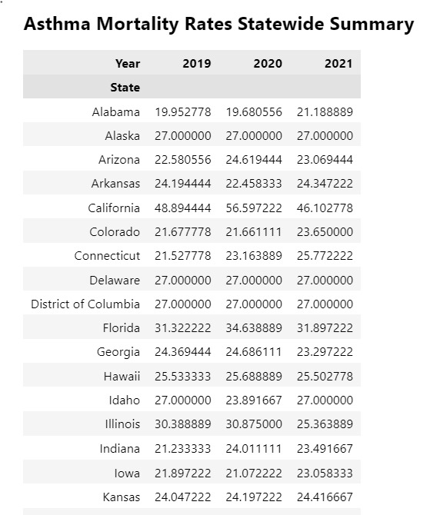
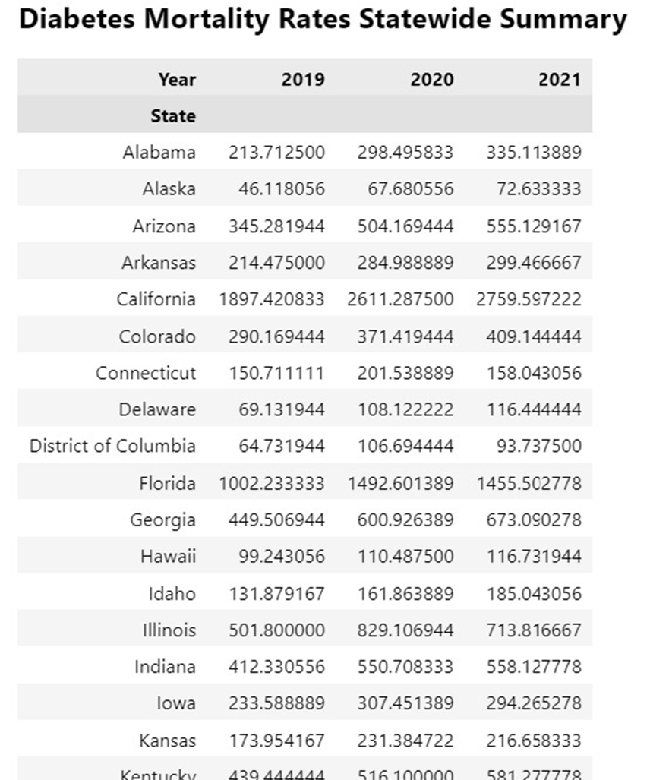
Summary Tables of Asthma & Diabetes Mortality Rates (2019-2021)

Slide 9
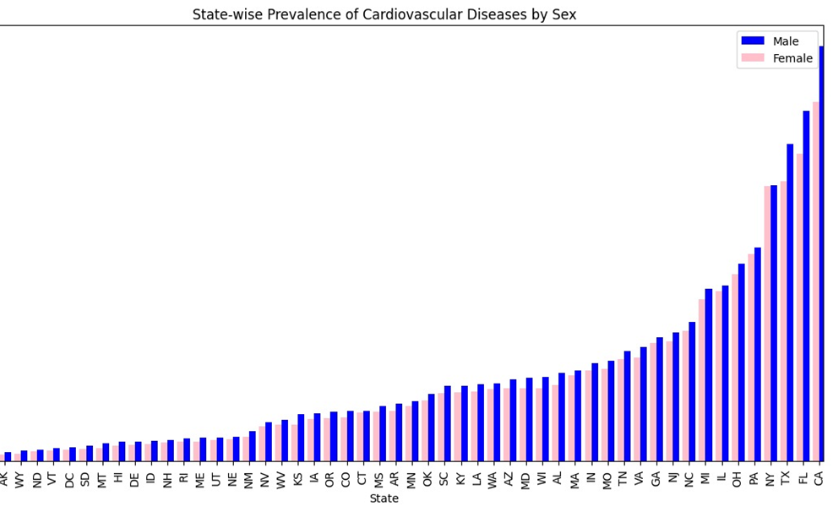
2. State-wise Disease Prevalence Analysis

Slide 10
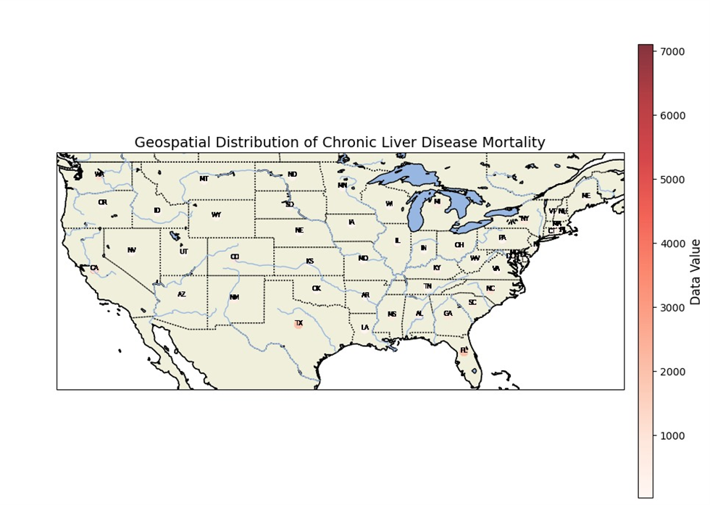
3. Geospatial Distribution of Chronic Liver Disease Mortality

Slide 11
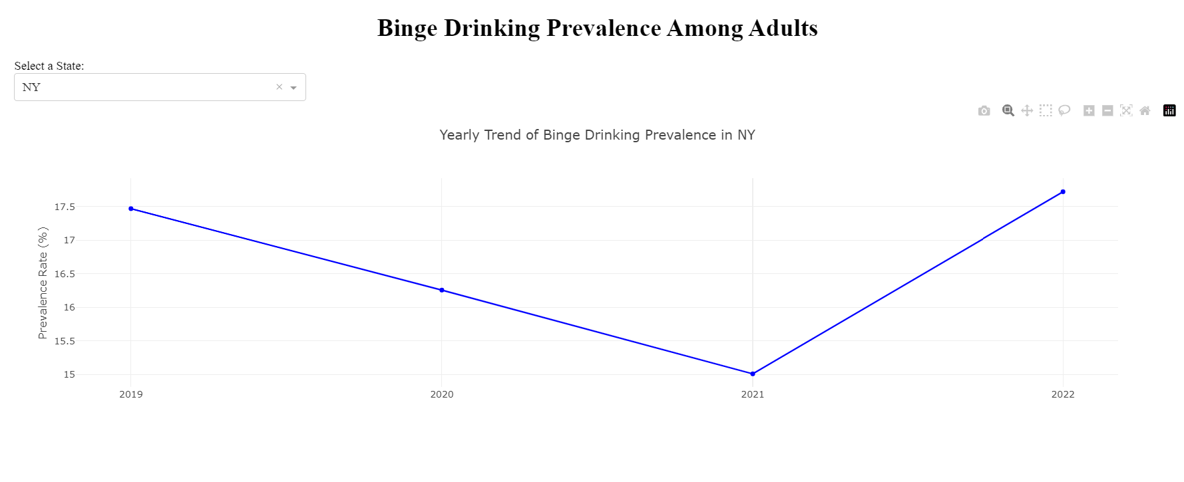
4. Interactive Dashboard

Slide 12

Conclusion
•The data reveals significant regional and demographic disparities in chronic disease prevalence and mortality, with certain states like California and Florida showing consistently higher rates.
•The COVID-19 pandemic likely influenced the increase in mortality rates, especially in 2020, as external factors exacerbated underlying health conditions.

Slide 13

Insights for Action
• Tailored public health strategies and interventions should be implemented in regions with high mortality rates to address chronic disease trends effectively.
• Continuous monitoring and targeted outreach to high-risk populations, such as those in states with rising trends, can help mitigate future health crises and reduce mortality rates.

Slide 14
Thank you

